Slide 1
Course Title: OOP 2 Course Code: CSC 2210
Dept. of Computer Science
Faculty of Science and Technology
Topis: C# Basics
Lecturer No: | 1 | Week No: | 1 | Semester: | Fall 2022-23
Lecturer: | Nyme Ahmed (nyme.ahmed@aiub.edu)

Slide 2
Lecture Outline
Assessment and Evaluation
Rules and Guidelines
Introduction about C#
Installation Guidelines
First C# Program and Syntax
Value Types
Type Casting
C# User Input
C# Operators
Strings

Slide 3
Assessment and Evaluation
Assessment strategy for Mid term:
Attendance
Quiz (Best 1 out of 2)
Lab Exam
Mid Exam

Slide 4
Assessment and Evaluation
Grading Policy:
Marking System for Mid |  | Marking System for Final
Attendance | 10 | Attendance | 10
Quiz | 20 | Performance | 10
Lab Exam | 20 | Quiz/ Assignment | 20
Mid Exam | 50 | Project + Viva | 40 + 20
Total | 100 | Total | 100
Grand Total: Mid 40% + Final 60%

Slide 5
Rules and Guidelines
Must be present inside the class in due time.
Break time: 15-20 minutes (max) break will be given in the middle of the class.
Must have at least 80% attendance to pass this course. Failure to do so will result in an automatic UW.
Must appear in the mid exam.
No make-up quiz/lab exam.
No bonus request! (May be given for any good performances)
No cheating, you’ll get an F in the course.

Slide 6
Introduction about C#
C# is an object-oriented programming language created by Microsoft that runs on the .NET Framework.
C# in case-sensitive.
C# is used for mobile/desktop/web/database applications, websites, games and many more.
Tool used for C#: Microsoft Visual Studio

Slide 7
Introduction about C#
Why we need C#?
Most popular object-oriented language which gives a clear structure to programs and allows code to be reused, lowering development costs.
Easy to learn and simple to use.
Has a huge community support.

Slide 8
Installation Guidelines
We will use Visual Studio Community.
Link: https://visualstudio.microsoft.com/vs/community/
After downloading the VS Community, choose the “.NET desktop development” and click on the Install button.
After installation, Visual Studio will automatically launch.
Then set the development settings from ‘General’ to ‘Visual C#’. After that, click ‘Start Visual Studio’.

Slide 9
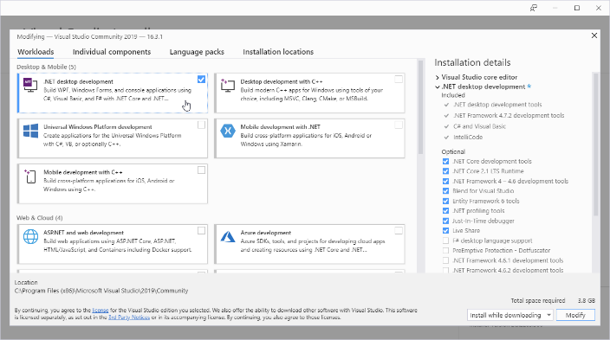
Installation Guidelines

Slide 10
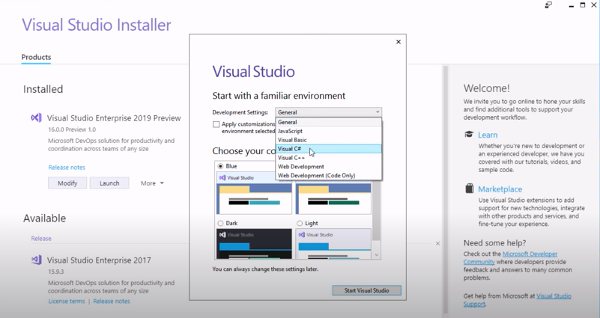
Installation Guidelines

Slide 11
First C# Program and Syntax
using System;
namespace ProjectName
{
class Program
{
static void Main(string[] args)
{
Console.WriteLine("Hello World!");
}
}
}

Slide 12
First C# Program and Syntax
using System means that we can use classes from the System namespace.
namespace is used to organize your code.
class is a container for data and methods. Every line of code that runs in C# must be inside a class.
Another thing that always appear in a C# program, is the Main method. Any code inside its curly brackets {} will be executed.
Console is a class of the System namespace, which has a WriteLine() method that is used to print text.

Slide 13
Value Types

Slide 14
Type Casting
Type casting is when you assign a value of one data type to another type.
In C#, we can perform the following type casting-
Implicit Casting: Converting a smaller type to a larger type. (char -> int -> long -> float -> double)
Explicit Casting: converting a larger type to a smaller type. (double -> float -> long -> int -> char)
Conversion with the helper classes

Slide 15
Type Casting
Implicit Casting: Done automatically when passing a smaller size type to a larger size.
Example:
int myInt = 12;
double myDouble = myInt; // Automatic casting: int to double
Console.WriteLine(myInt); // Output: 12
Console.WriteLine(myDouble); // Output: 12

Slide 16
Type Casting
Explicit Casting: Must be done manually when passing a larger size to a smaller size.
Example:
double myDouble = 3.95;
int myInt = (int) myDouble; // Manual casting: double to int
Console.WriteLine(myDouble); // Output: 3.95
Console.WriteLine(myInt); // Output: 3

Slide 17
C# User Input
Console.WriteLine("Enter your university name:");
string name = Console.ReadLine();
Console.WriteLine("University name is: " + name);
Remember that Console.ReadLine() method returns a string.

Slide 18
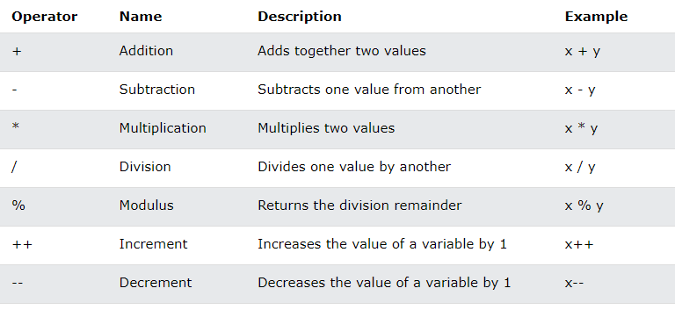
C# Operators
Arithmetic Operators:

Slide 19
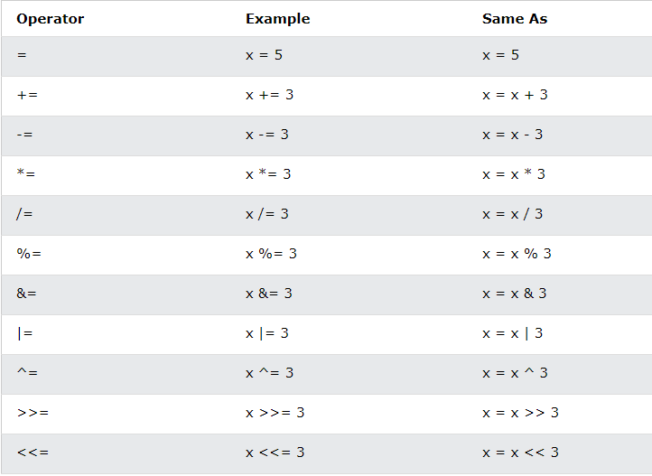
C# Operators
Assignment Operators:

Slide 20
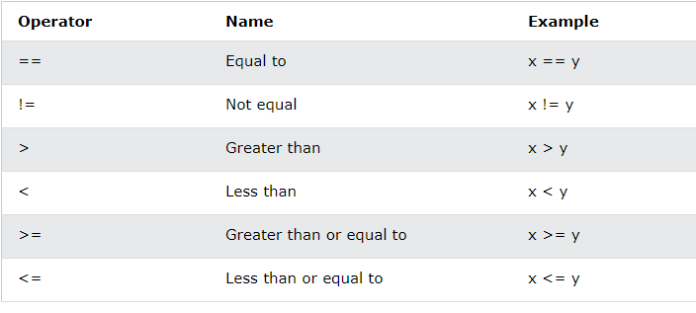
C# Operators
Comparison Operators:

Slide 21
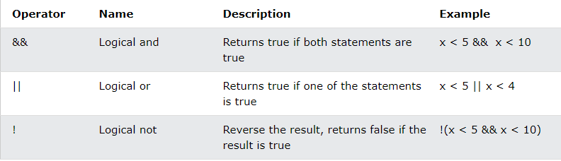
C# Operators
Logical Operators:

Slide 22
Strings
A string variable contains a collection of characters surrounded by double quotes.
String length: By using the Length property.
string txt = “Hello World!”
Console.WriteLine(“Length is: " + txt.Length);
Upper-lower conversion: By using ToUpper() and ToLower()
string txt = "Hello World!";
Console.WriteLine(txt.ToUpper());
Console.WriteLine(txt.ToLower());

Slide 23
Strings
Concatenation: + operator is used.
string firstName = "Anik “;
string lastName = "Islam";
string name = firstName + lastName;
Console.WriteLine(name);
Also used string.Concat() method.
string firstName = "Anik “;
string lastName = "Islam";
string name = string.Concat(firstName, lastName);
Console.WriteLine(name);

Slide 24
Strings
Access String: by referring to its index number inside [].
string x = “AIUB";
Console.WriteLine(x[1]);
Special Characters: by using \”
string x = "AIUB is in \"Dhaka\"";
Console.WriteLine(x);

Slide 25
Strings
C# uses the + operator for both addition and concatenation.
Numbers are added.
Strings are concatenated.
int x1 = 5;
int y1 = 5;
int z1 = x1 + y1;
Console.WriteLine(z1);
string x2 = “5”;
string y2 = “5”;
string z2 = x2 + y2;
Console.WriteLine(z2);

Slide 26
Course Title: OOP 2 Course Code: CSC 2210
Dept. of Computer Science
Faculty of Science and Technology
Topis: C# Basics
Lecturer No: | 2.1 | Week No: | 2 | Semester: | Fall 2022-23
Lecturer: | Nyme Ahmed (nyme.ahmed@aiub.edu)

Slide 27
Identifiers
Identifiers are case sensitive.
Can not start with a number
Can not have white space (blank space)
Can not be a reserved keyword
Try using meaningful names. Underscore character is allowed.

Slide 28
Naming Conventions
There are 3 types of naming conventions.
Camel Case: firstName
Pascal Case: FirstName
Hungarian Notation: Not used in C#
For local variable: Must use Camel Case.
For constant variable: Use Pascal Case.

Slide 29
User Input/Output
User Input:
Console.Read(); // returns int (ASCII value)
Console.ReadLine(); // returns string
User Output:
Console.Write(); // no line break
Console.WriteLine(); //Line break after executing

Slide 30
Data Types
C# supports 2 kinds of data types.
Value type: Value types are so-called because they contain the actual value of the data they store.
For example, int a = 3
Reference type: Also known as objects. Reference types are created from class files. A reference type stores a reference to the location in memory of the object. If you are familiar with C/C++ then you can think of a reference to the memory location to be the same as a pointer. C# does not require you to use pointers.

Slide 31
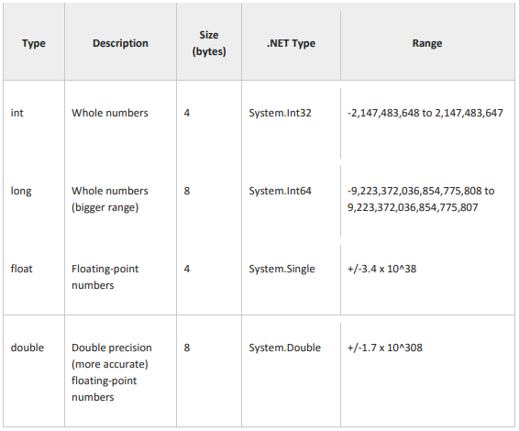
Data Types
Value types:
(Updated!)

Slide 32

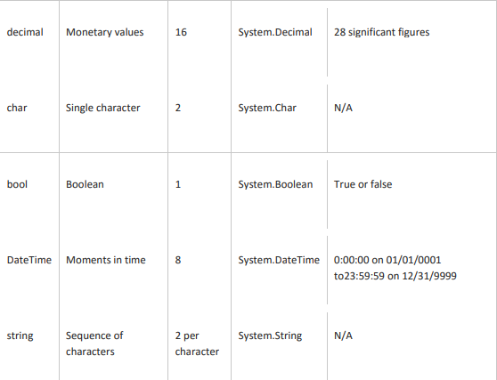
Data Types
Value types:
(Updated!)

Slide 33
Data Types
Reference types:
The reference data types do not contain the actual data stored in a variable, but they contain a reference to the variables.
If the data is changed by one of the variables, the other variable automatically reflects this change in value.
There are 2 types of reference data type in C#.
Predefined types: Such ad Object, String.
User defined types: Such as Classes, Interface.

Slide 34
Type Casting
Implicit Casting: Discussed in lecture 1
Explicit Casting: Discussed in lecture 1
C# also provides some other mechanisms to deal with casting type (from string to other data type).
Convert.TodataType() // Convert.ToInt32(Console.ReadLine());
dataType.Parse() // Int32.Parse(Console.ReadLine());
dataType.TryParse(string, out variableName)

Slide 35
Type Casting
Example of Convert.TodataType:
Console.Write("Enter first number:");
int num1 = Convert.ToInt32(Console.ReadLine());
Console.Write("Enter second number:");
int num2 = Convert.ToInt32(Console.ReadLine());
int sum = num1 + num2;
Console.WriteLine("The sum of {0} and {1}: {2}", num1, num2, sum);

Slide 36
Type Casting
Example of dataType.Parse() and dataType.TryParse():
int num1 = Int32.Parse(Console.ReadLine()); //4
Console.WriteLine(num1); //4
string a = Console.ReadLine(); //AIUB
Console.WriteLine(Int32.TryParse(a, out int b)); //False
string a = “AIUB”;
Console.WriteLine(Int32.Parse(a)); //Unhandled exception!!
string a = Console.ReadLine(); //4
Console.WriteLine(Int32.TryParse(a, out int b)); //True
Scenario 1
Scenario 2

Slide 37
Type Casting
Difference between Parse() and TryParse():
Parse() | TryParse()
Can not handle exception. | Can handle exception.
Only one parameter. | Two parameters are used.
Can not return Boolean value. | Return type: Boolean value (True or False)

Slide 38
Constants
A constant is an object whose value can’t be changed. They are used to prevent reassignment.
(Attempt to reassign a constant results in compiler error!)
Constants come in three flavors.
Literals
Symbolic Constants
Enumerations

Slide 39
Constants
Literals: 32 is a literal you can not change its value.
Symbolic Constants: Assign a name to a constant value. You declare a symbolic constant using the const keyword and the following syntax:
const type identifier = value;
You must initialize a constant when you declare it, and once initialized it, it can’t be altered. Example-
const int FreezePoint = 32;
Here, 32 is literal constant and FreezePoint is a symbolic constant of type int.

Slide 40
Constants
Enumerations:
It is a distinct value type, consisting of a set of named constants. Also known as enumerator list.
The enum keyword is used to declare an enumerations.
By default, the first enumeration has the value 0, and the value of each successive enumerator is increased by 1. For example, in the following enumeration, Sat is 0, Sun is 1, Mon is 2, and so on.
enum DayName {Sat, Sun, Mon, Tues, Wed, Thurs, Fri};

Slide 41
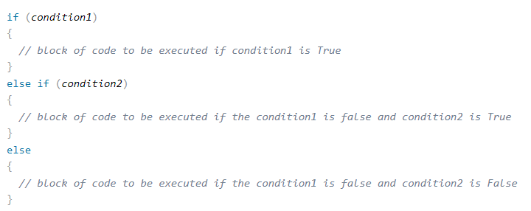
if, else, else if
Use the if statement to specify a block of C# code to be executed if a condition is True.
Use the else statement to specify a block of code to be executed if the condition is False.
Use the else if statement to specify a new condition if the first condition is False.
Syntax

Slide 42
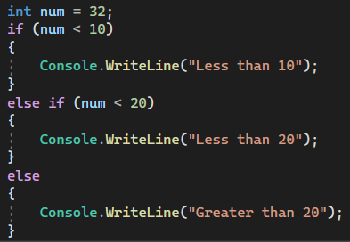
if, else, else if
What will be the output??

Slide 43
Switch
Switch is used to select one of many code blocks to be executed.
break keyword, it breaks out of the switch block.
The default keyword is optional and specifies some code to run if there is no case match.

Slide 44
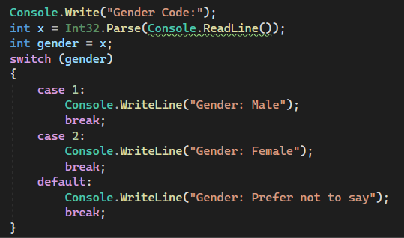
Switch
What will be the output??

Slide 45
Repetition
Visual C# provides a number of standard constructs known as loops that you can use to implement iteration logic.
for loop
The for loop executes a block of code repeatedly until the specified expression evaluates to false. You can define a for loop as follows.
for ([initializers]; [condition]; [iterator])
{
// code to repeat goes here
}

Slide 46
Repetition
while loop
The test condition is given in the beginning of the loop and all statements are executed till the given condition satisfies.
while (condition)
{
loop statements...
}

Slide 47
Repetition
do-while Loop
do while loop is similar to while loop with the only difference that it checks the condition after executing the statements.
do
{
statements..
}while (condition);

Slide 48
Repetition
for each Loop
There is also a foreach loop, which is used exclusively to loop through elements in an array.
foreach (type variableName in arrayName)
{
// code block to be executed
}

Slide 49
Break/Continue in Loops
The break statement can also be used to jump out of a loop.
The continue statement skips one iteration in the loop.
for (int i = 0; i < 5; i++)
{
if (i == 3)
{
break;
}
Console.Write(i +” “);
}
Output: 0 1 2
for (int i = 0; i < 5; i++)
{
if (i == 3)
{
continue;
}
Console.WriteLine(i);
}
Output: 0 1 2 4

Slide 50
Methods
A method is a block of code which only runs when it is called. Example-
class Program {
static void Main(string[] args) {
CallMethod();
}
static void CallMethod() {
Console.WriteLine("Method is called!");
}
}
Here, static means that the method belongs to the Program class and not an object of the Program class.

Slide 51
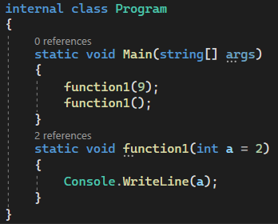
Methods
Default Parameter:
Created by using the equal (=) sign.
Call the method without an arguments means called the default value.

Slide 52
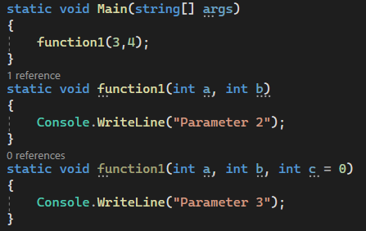
Methods
Multiple Parameter:

Slide 53
Methods
Named Parameter:
static void Main(string[] args)
{
function1(3,c:5);
}
static void function1(int a, int b = 0, int c = 1)
{
Console.WriteLine("{0} {1} {2}",a,b,c);
}

Slide 54
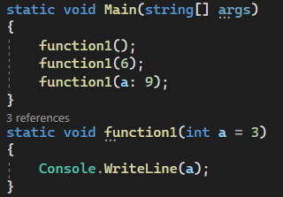
Methods
What will be the output??

Slide 55
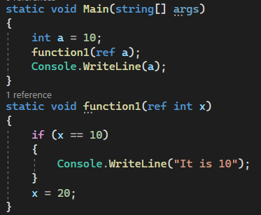
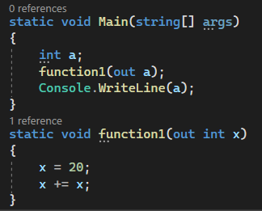
Use of Ref and Out Keywords
Ref: Out:

Slide 56
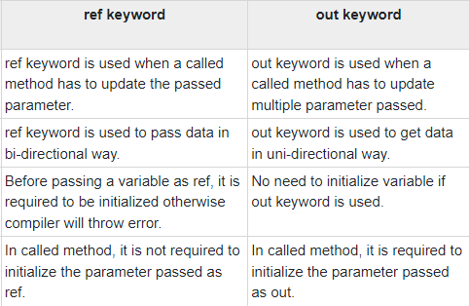
Use of Ref and Out Keywords
Differences between Ref and Out:

Slide 57
Struct
Used to hold small data values.
The struct keyword is used for creating a structure.
Structures can have defined constructors, but not destructors. However, you cannot define a default constructor for a structure. The default constructor is automatically defined and cannot be changed.
Structures cannot inherit other structures or classes.
Structures cannot be used as a base for other structures or classes.

Slide 58
Struct
static void Main(string[] args) {
Coordinate point;
point.x = 20;
point.y = 40;
Console.WriteLine(point.x); //output: 20
Console.WriteLine(point.y); //output: 40
}
struct Coordinate{
public int x;
public int y;
}

Slide 59
Course Title: OOP 2 Course Code: CSC 2210
Dept. of Computer Science
Faculty of Science and Technology
Topis: Array
Lecturer No: | 2.2 | Week No: | 2 | Semester: | Fall 2022-23
Lecturer: | Nyme Ahmed (nyme.ahmed@aiub.edu)

Slide 60
Array
Introducing Array:
Array is a sequence of elements, all of which are the same type. You can build simple arrays that have one dimension (a list), two dimensions (a table), three dimensions (a cube), and so on.
Every element in the array contains a value.
Arrays are zero-indexed, that is, the first item in the array is element 0.
The size of an array is the total number of elements that it can contain.

Slide 61
Array
Introducing Array:
An array has the following properties:
An array can be Single-Dimensional, Multidimensional or Jagged.
The number of dimensions and the length of each dimension are established when the array instance is created. These values can’t be changed during the lifetime of the instance.
The default value of numeric array elements are set to zero, and reference elements are set to null.

Slide 62
Array
Declaring Array:
When you declare an array, you specify the type of data that it contains and a name for the array. When you use the new keyword, array is created. At this point, you should specify the size of the array.
Syntax:
dataType[] arrayName = new dataType [size];
Example:
int[] arrayName = new int[10];

Slide 63
Array
Declaring Array:
You can also choose to create an array and initialize it with values at the same time as in the following example that declares an integer array and assigns values to it. The compiler know how large to make the array by the number of values in the curly braces:
int[] arrayName = {1,2,3,4,5,6,7,8};
or
int[] arrayName = new int[] {1,2,3,4,5,6,7,8};

Slide 64
Array
Array as objects:
In C#, arrays are actually objects.
Array is the abstract base type of all array types. We can use the properties and other class members, that Array has.
int[] number = { 1, 2, 3, 4, 5 };
int length = number.Length;
Console.WriteLine("Length of the array is {0}",length);
Console.WriteLine(“It is {0} dimension",number.Rank);

Slide 65
Array
Accessing data in an array:
You can access data in an array in several ways, such as by specifying the index of a specific element that you require or by iterating through the entire array and returning each element in sequence.
int[] oldNumbers = { 1, 2, 3, 4, 5 };
int number = oldNumbers[2];
for (int i = 0; i < oldNumbers.Length; i++){
int number = oldNumbers[i];
...}

Slide 66
Array
Single-Dimension array (1D Array):
You can declare a single dimension array of five integers as shown in the following example.
int[] arrayName = new int[5];
An array that stores string elements can be declared in the same way. Example-
string[] arrayName = new string[6];

Slide 67
Array
Multidimensional array:
An array can have more than one dimension. You can specify up to 32 dimensions, but you will rarely need more than three.
You declare a multidimensional array variable just as you declare a single-dimensional array, but you separate the dimensions by using commas.
For example, the following declaration creates a 2D array of 4 rows and 2 columns.
int[,] arrayName = new int [4,2];

Slide 68
Array
Multidimensional array:
We can also initialize the array without specifying the numbers of row and column.
int[,] arrayName = {{1,2},{3,4},{5,6},{7,8}}
In order to access elements in a multidimensional array, you must include all indices such as-
int value1 = arrayName[0,0];
int value2 = arrayName[0,1];

Slide 69
Array
Jagged array:
A jagged array is an array whose elements are arrays. The elements of jagged array can be of different dimensions and sizes. A jagged array is sometimes called an ‘array of arrays’.
Jagged arrays are useful for modeling sparse data structures where you might not always want to allocate memory for every item if it is not going to be used.
The following is the declaration of the jagged array that has three elements and each element is 1D array of integers.
int [][] jaggedArray = new int[3][];

Slide 70
Array
Jagged array:
Before using jagged array, its elements must be initialized. We can initialize the elements like this:
jaggedArray[0] = new int[5];
jaggedArray[1] = new int[4];
jaggedArray[2] = new int[2];
It is also possible to use initializers to fill the array elements with values.
jaggedArray[0] = new int[] {1,2,3,4,5};
jaggedArray[1] = new int[]{2,4,6,8};
jaggedArray[2] = new int[]{5,10};

Slide 71
Array
Jagged array:
We can also initialize the array upon declaring like this:
int[][] jaggedArray2 = new int[][]
{
new int[] {1,3,5,7,9},
new int[] {2,4,6,8},
new int[] {0,5,10}
};

Slide 72
Array
Jagged array:
We can access individual array elements in jagged array like these example:
//Assign 77 to the second element of first array
jaggedArray[0][1] = 77;
//Assign 84 to the second element of second array
jaggedArray[1][1] = 84

Slide 73
Array
Jagged array:
The following is a declaration and initialization of a three elements jagged array and each element is 2D array of integers.
int[][,] jaggedArray2 = new int[3][,]
{
new int[,]{ {1,3},{5,7} },
new int[,]{ {0,2},{4,6},{7,8} },
new int[,]{ {1,2},{2,3},{3,4} }
};

Slide 74
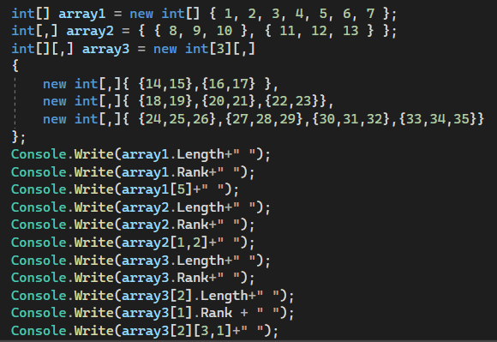
Array
What will be the output??
Output:
7 1 6 6 2 13 3 1 12 2 34

Slide 75
Array
Using foreach with arrays:
The foreach statement processes elements in the order returned by the array, which is usually from the 0th element to the last. Example-
int[] number = { 1, 2, 3, 4, 5, 6 };
foreach(int i in number)
{
Console.Write(i + " ");
}

Slide 76
Array
Passing arrays as arguments:
Array can be passed as arguments to method parameters.
Arrays are reference type, the method can change the value of the elements.
int[] theArray = {1,3,5,7};
PrintArray(theArray);
void PrintArray(int[] arr)
{
//method code
}

Slide 77
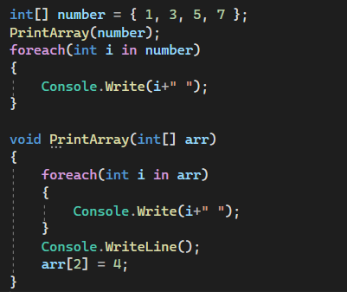
Array
What will be the output??
Output:
1 3 5 7
1 3 4 7

Slide 78


Slide 79
Books
C# 4.0 The Complete Reference; Herbert Schildt; McGraw-Hill Osborne Media; 2010
Head First C# by Andrew Stellman
Fundamentals of Computer Programming with CSharp – Nakov v2013

Slide 80
Course Title: OOP 2 Course Code: CSC 2210
Dept. of Computer Science
Faculty of Science and Technology
Topics: Class & Object, Encapsulation
Lecturer No: | 04 | Week No: | 04 | Semester: | Fall 2022-23
Lecturer: | Nyme Ahmed (nyme.ahmed@aiub.edu)

Slide 81
Class & Object
In Visual C#, you can define your own custom types by creating classes. As a programming construct, the class is central to object-oriented programming in Visual C#. It enables you to encapsulate the behaviors and characteristics of any logical entity in a reusable and extensible way.
The class defines the behaviors and characteristics, or class members, which are shared by all instances of the class. You represent these behaviors and characteristics by defining methods, fields, properties, and events within your class.
Class is a blueprint of an object. A class can be thought as a “type”, where the objects being a “variable” of that type.

Slide 82
Class & Object
Classes are reference type. There are two fundamental types of classes.
Concrete: You can create instances of them
Abstract: You can’t create instances of them
You use the ‘class’ keyword to declare a class, as shown in the following example:
//declaring a class
public class DrinkMachine
{
//methods, fields, properties, events
}
Here, the class keyword is preceded by an access modifier, such as public.

Slide 83
Class & Object
Classes can have the following members.
Constructor/Destructor
Fields
Methods
Indexers
Properties
Delegates and Events
Other types (e.g. structs, enums, interfaces, classes…)
Classes can implement interfaces and inherit from other classes.

Slide 84
Encapsulation
Encapsulation often considered the first pillar of object oriented programming.
Encapsulation can be used to describe the accessibility of the members belonging to a class or struct.
C# provides access modifiers and properties to help implement encapsulation in your classes.
Access modifiers control the “visibility” of a type or member to the types and members.
There are 5 types of access modifier.

Slide 87
Constructor
A special method of the class that will be automatically invoked when an instance of the class is created is called a constructor.
When you have not created a constructor in the class, the compiler will automatically create a default constructor in the class.
A constructor doesn’t have any return type, not even void.
A class have any number of constructors.
As any other method, constructor can be overloaded.

Slide 88
Constructor
There are 4 types of constructor in C#.
Default or Parameter less Constructor
Parameterized Constructor
Copy Constructor
Static Constructor
Default Constructor: It initializers-
All numeric fields in the class to zero.
All string and object fields to null.
This is the drawback of default constructor!!
(every instance of the class will be initialized to the same values)

Slide 89
Constructor
Parameterized Constructor:
A constructor with at least one parameter is called parameterized constructor.
The advantage of parameterized constructor is that you can initialize each instance of the class to different values.
Copy Constructor:
The constructor which creates an object by copying variables from another object is called a copy constructor.
The purpose of copy constructor is to initialize a new instance to the values of an existing instance.

Slide 90
Constructor
Static Constructor:
A static constructor does not take access modifiers or have any parameters.
A static constructor cannot be called directly. It called automatically to initialize the class before the first instance is created or any static members are referenced.
When a constructor is created as static, it will be invoked only once for all of instances of the class.
Within a class you can create only one static constructor.
The user has no control on when the static constructor is executed in the program.

Slide 91
Destructor
Destructor are the methods called by the Garbage Collector thread when the object is to be “finalized” (removing objects from memory).
C# destructors are “non-deterministic” i.e. finalization cannot be determined when that will happen.
In C#, most of the time you do not need to code destructor (or finalize) because you can trust Garbage Collector for that.

Slide 92
Fields
Called the state of objects. Variables declared outside any method /constructor but inside the class block, is a field (or field variable).
Variables that are declared within a method or a specific block of statements are local variables.
Local variables are kept alive as long as the execution is within the block they’re defined in. Once the block is exited, the local variables can no more be used. | Field variables have longer life than local variables in that they can live as long as the instance they belong to is active.
Local variable access is restricted to method only. | Field variable is the one which can have different access level.
Local variable is a member of a method. | Field variable is a member of a class.

Slide 93
Fields: Readonly
The keyword “readonly” will prevent field variable from being reassigned (from outside the class). The readonly keyword cannot be applied to local variables but to fields only.
The readonly keyword is different from the const keyword.
A const field can only be initialized at the declaration of the field whereas a readonly field can be initialized either at the declaration or in a constructor.
While a const field is a compile-time constant, the readonly field can be used for runtime constants.

Slide 94
Properties
A property is a programming construct that enables client code to get or set the value of private fields within a struct or a class. The property behaves like a public field.
The property is implemented by using accessors, which are a special type of method. A property can include one or both of the following:
A get accessor to provide read access to a field.
A set accessor to provide write access to a field.
Within the property, the get and set accessors use the following syntax:
The get accessor uses the return keyword to return the value of the private field to the caller.
The set accessor uses a special local variable named “value” to set the value of the private field. The value variable contains the value provided by the client code when it accessed the property.

Slide 95
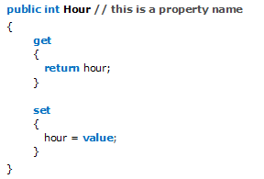
Properties
Example:
A property that includes only a get accessor is read-only, while a property that includes only a set accessor is write-only.

Slide 96
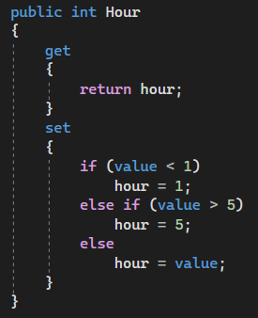
Properties
You can change the implementation of properties without affecting client code.
For example, you can add validation logic, or call a method instead of reading a field value.

Slide 97
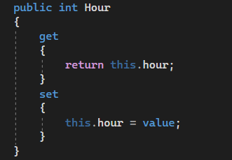
Indexers
An indexer is similar to a property, in that it uses get and set accessors to control access to a field.
To declare an indexer, you use the “this” keyword.

